Slide 1
Marginal Cell
Wing Width

Slide 2
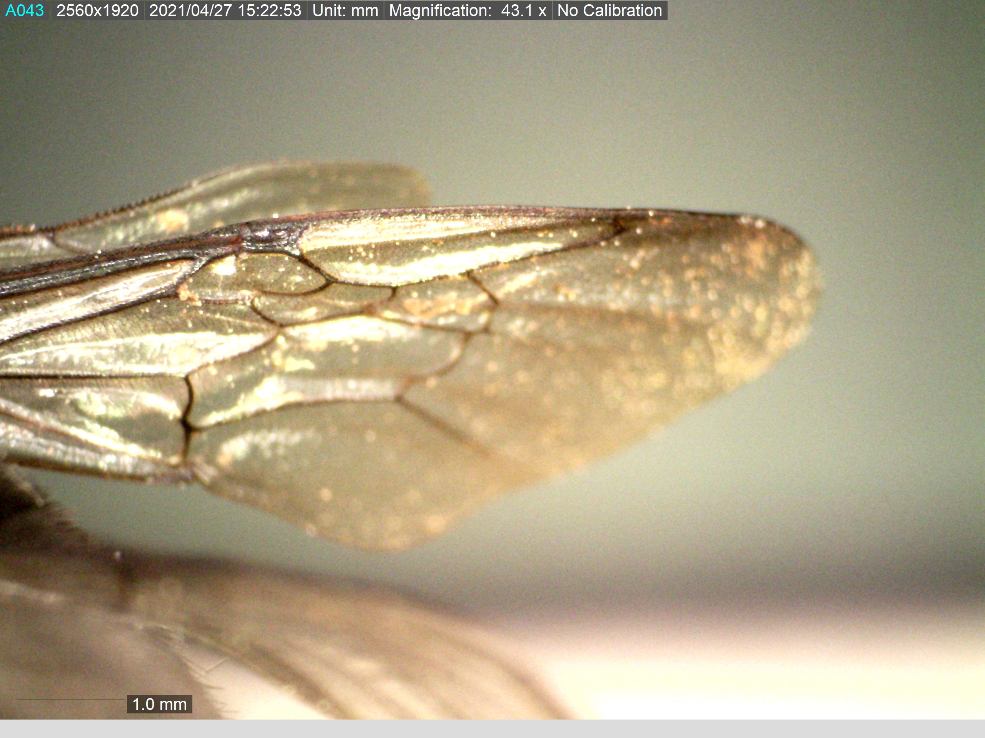
Marginal Cell
Wing Width

Slide 3
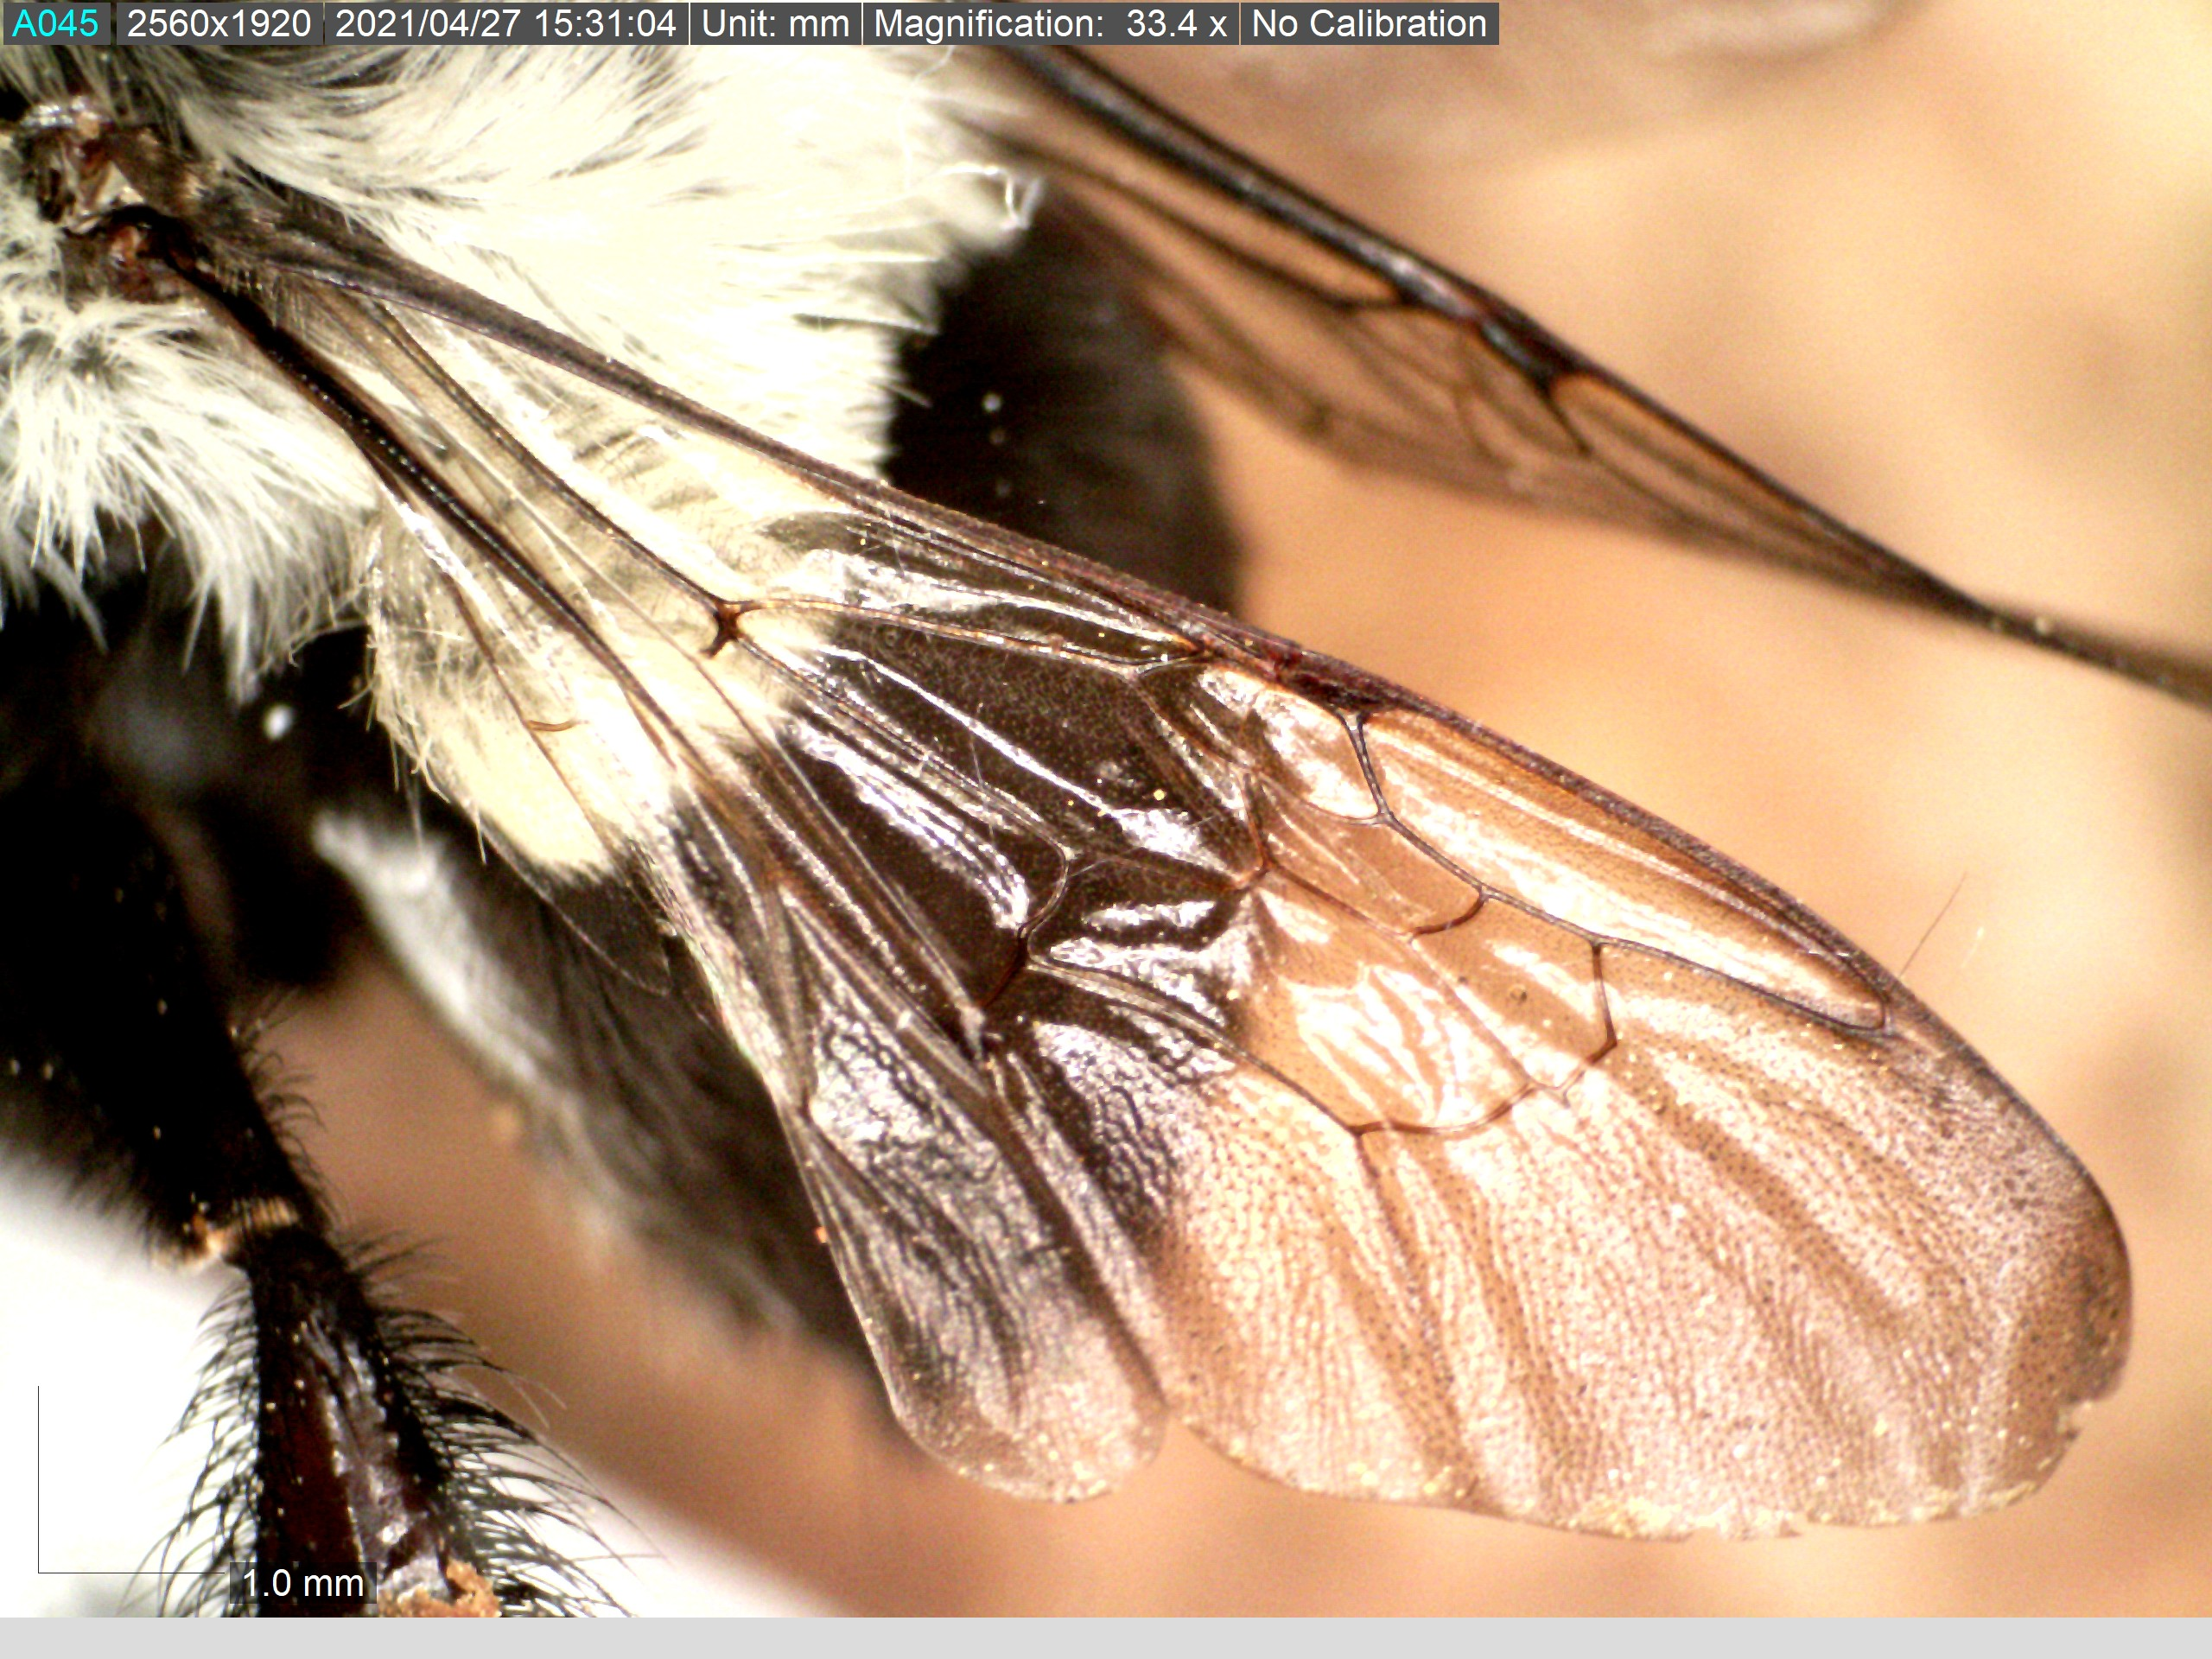
Marginal Cell
Wing Width
Wing Length

Slide 4
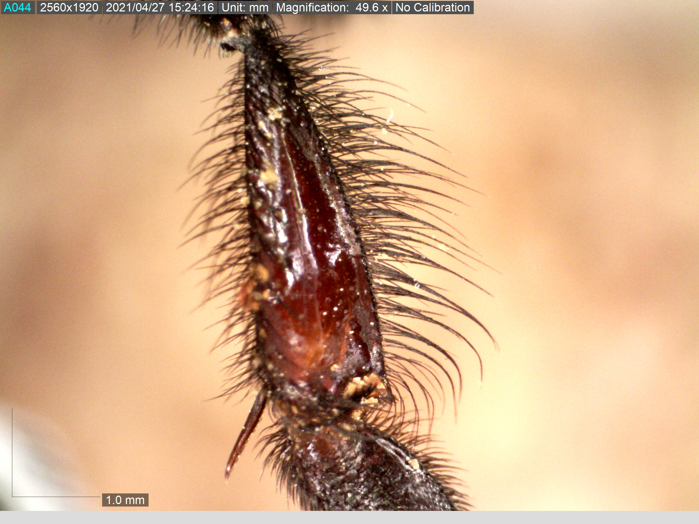
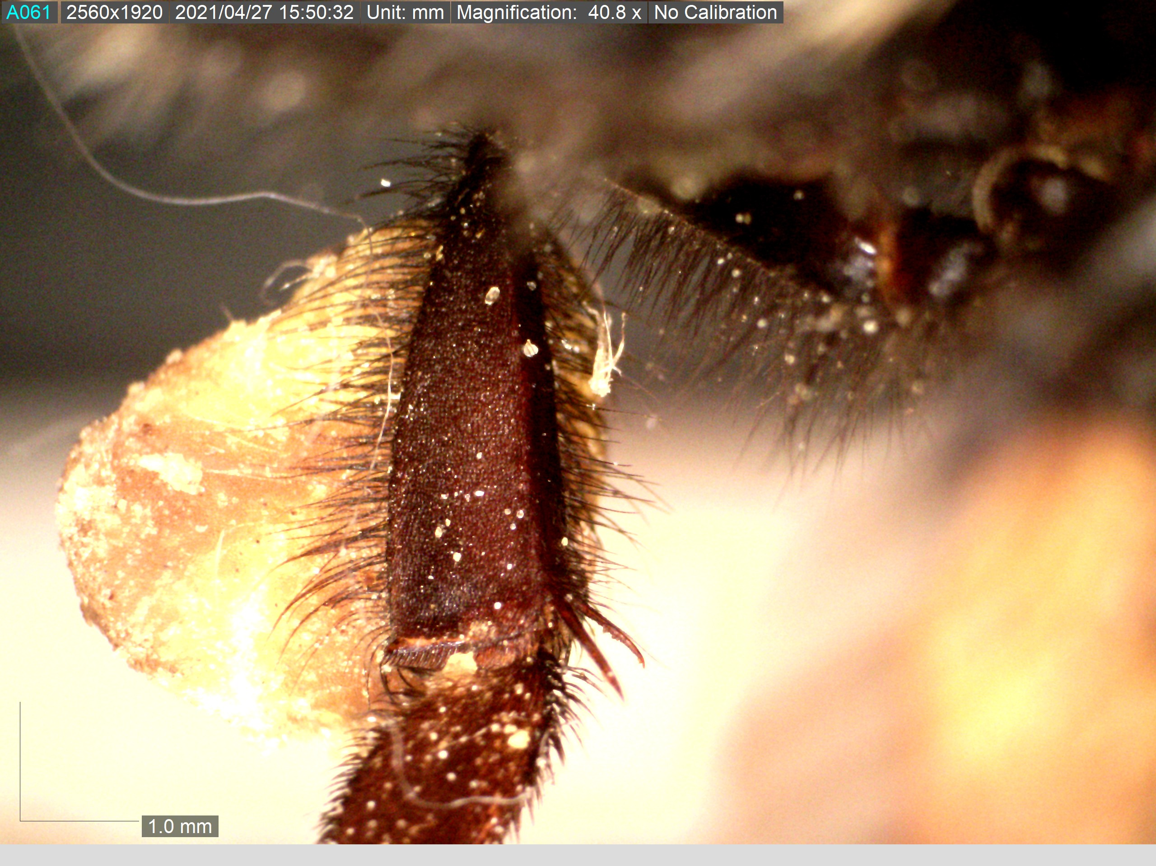
Length and width of the basitarsus

Slide 5
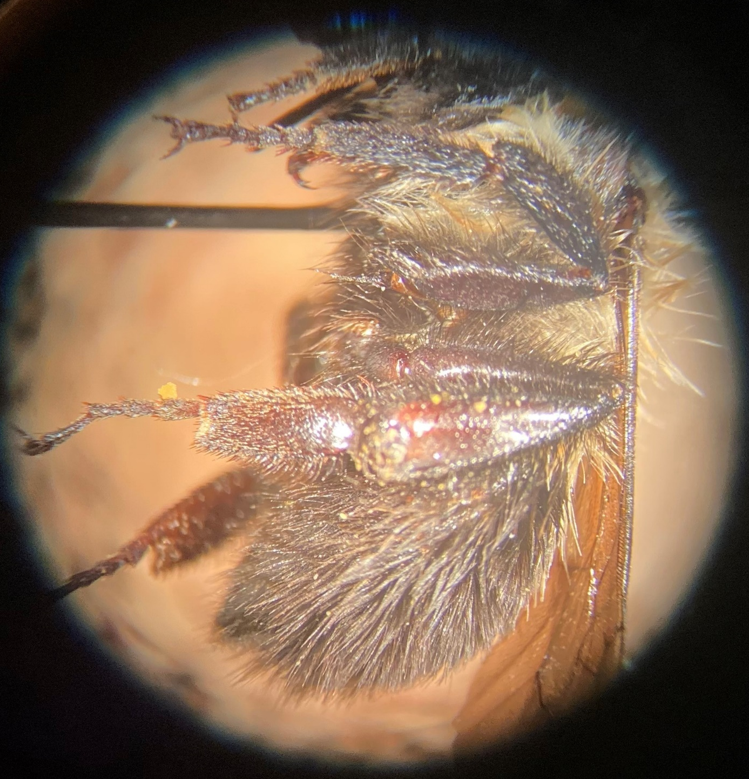
Length and width of the basitarsus

Slide 6
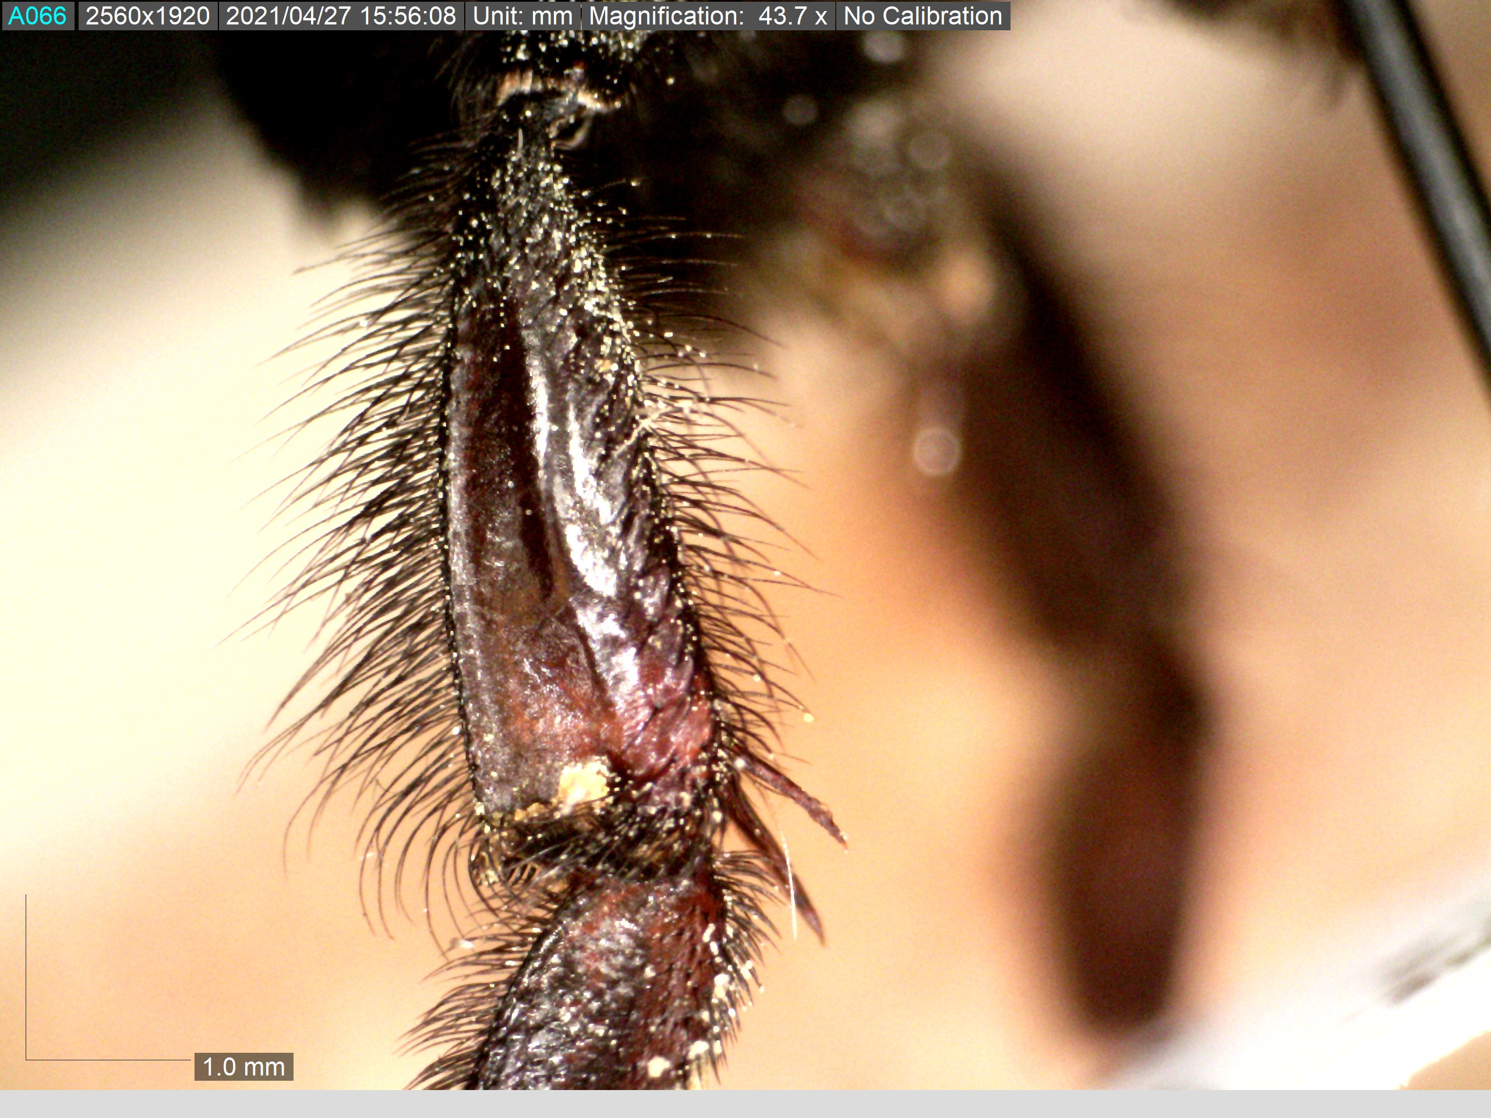
Length of setae near the base, middle, and apex of the basitarsus

Slide 7
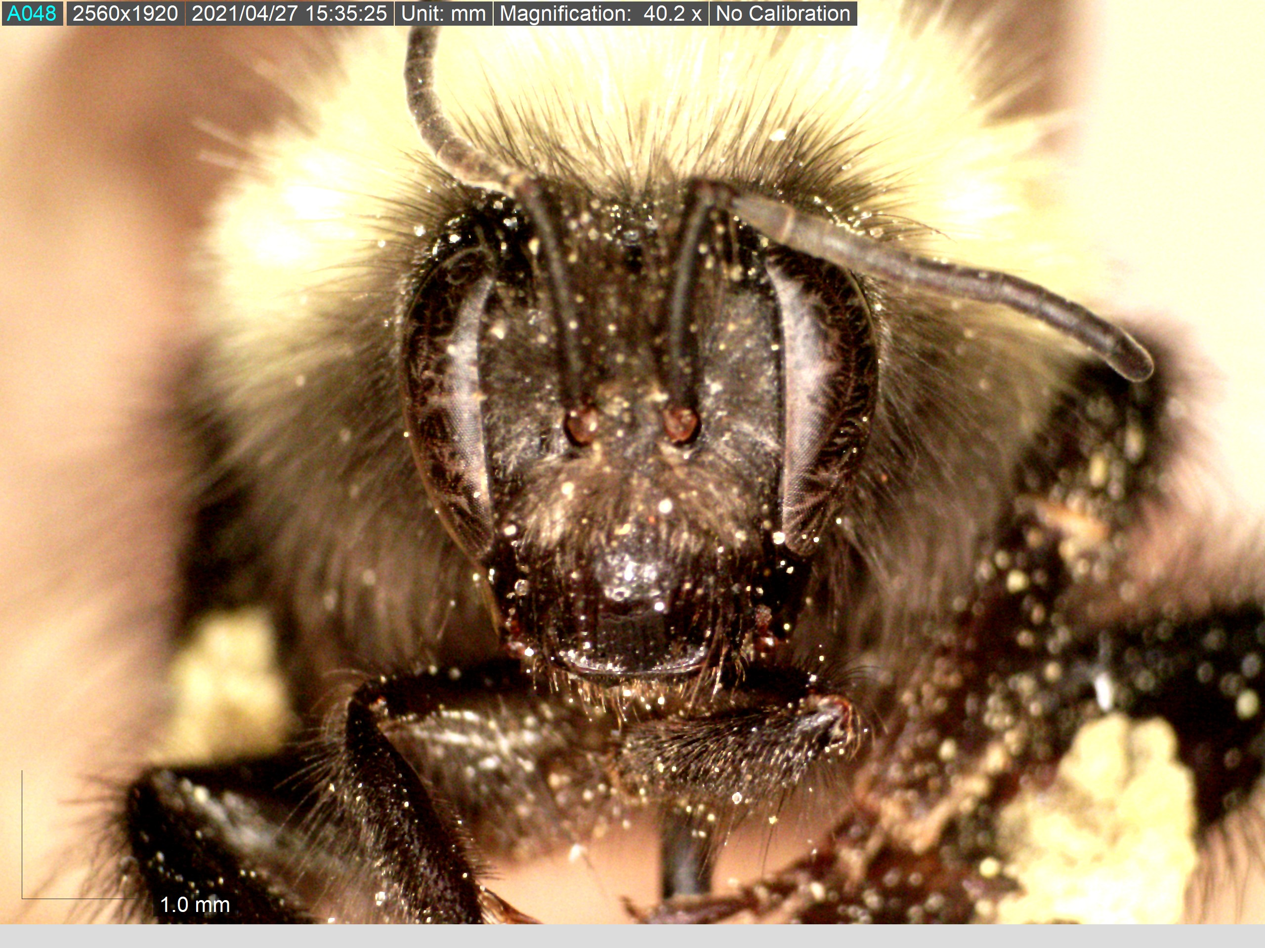
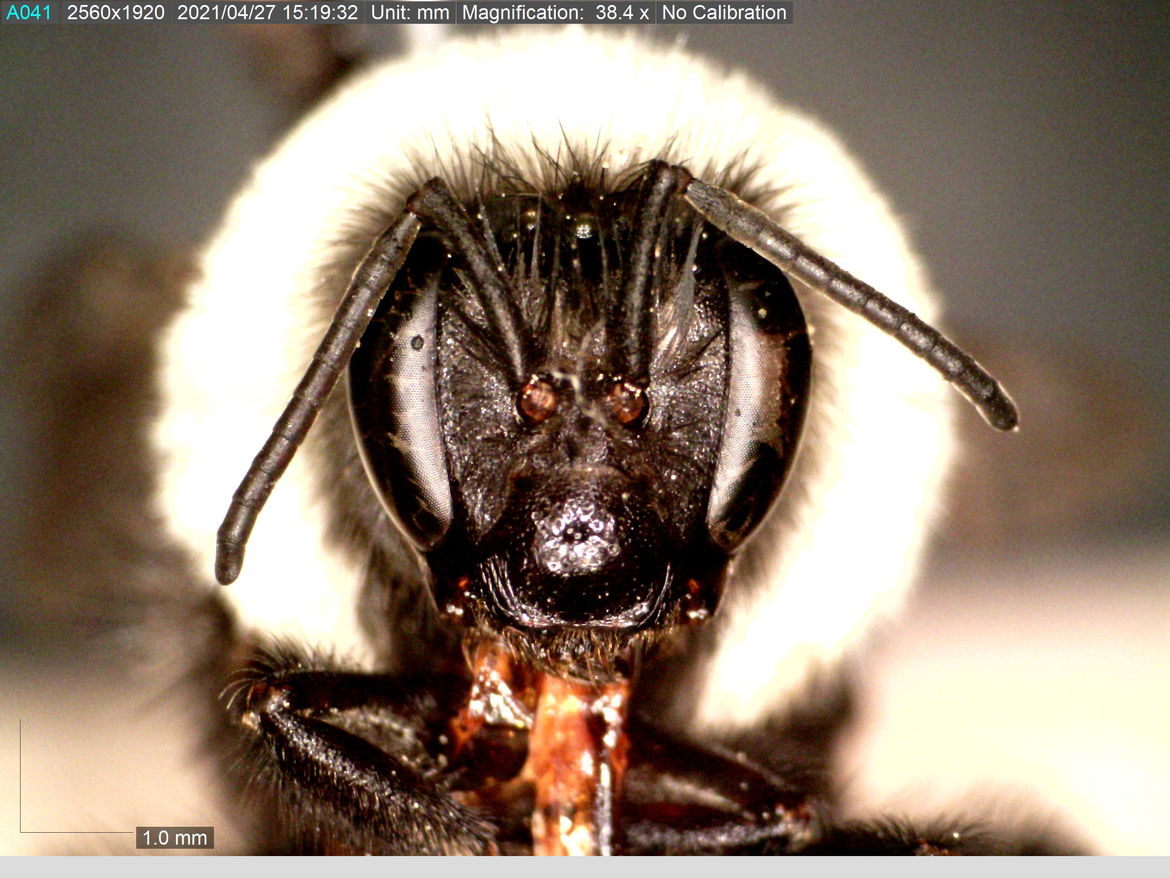
Scape length
Head width

Slide 8
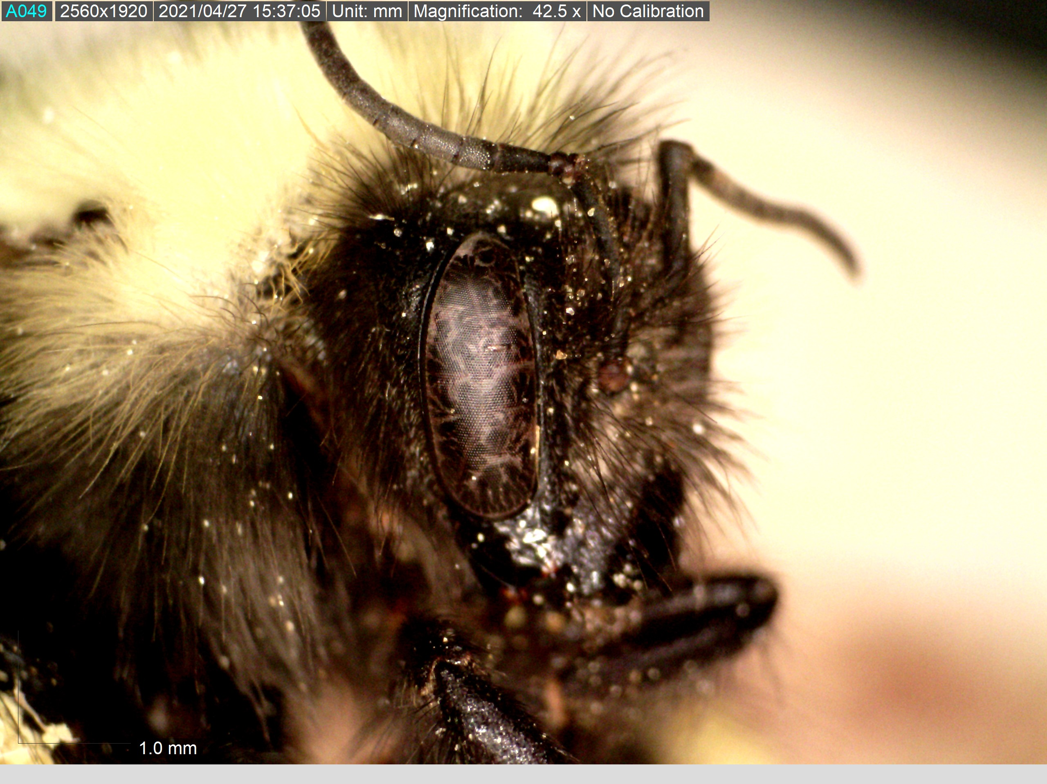
Eye length and width

Slide 9
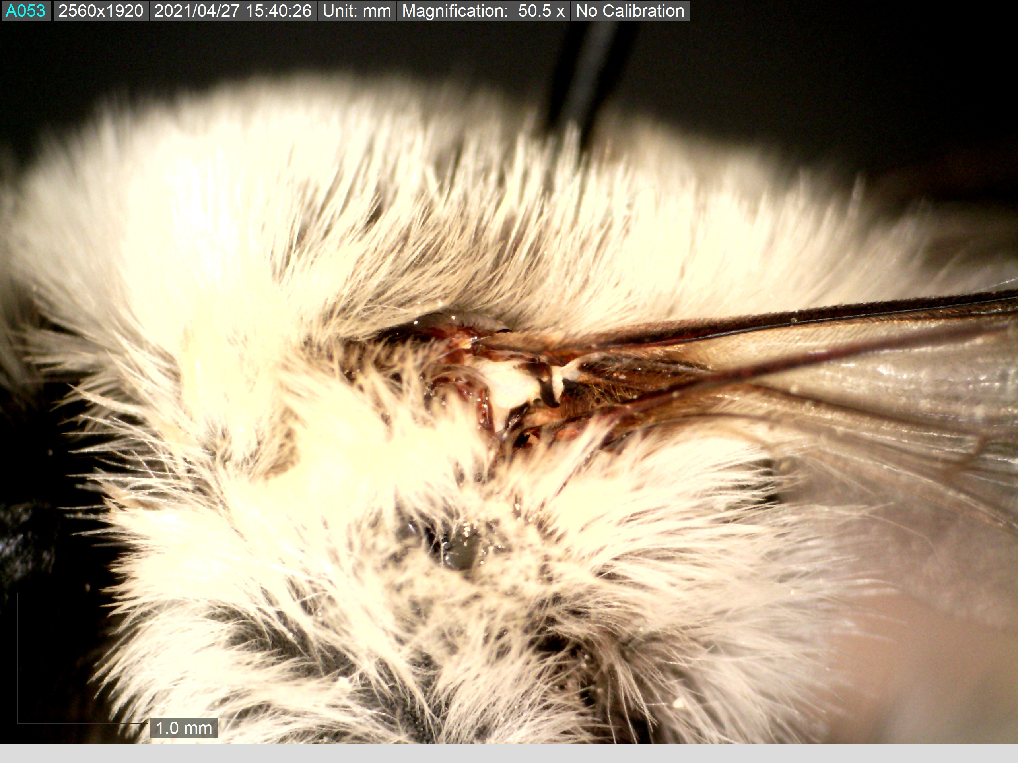
Length of hair on side of thorax

Slide 10
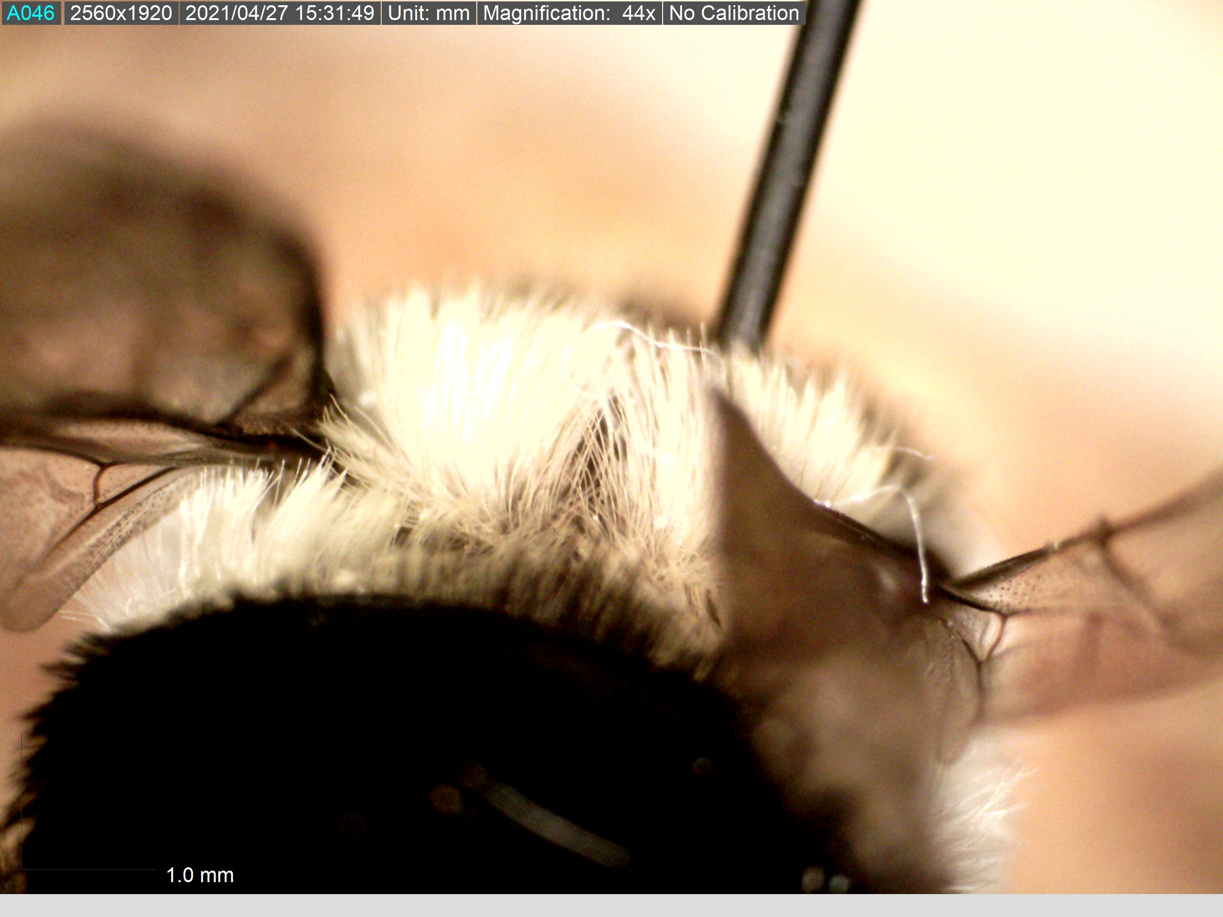
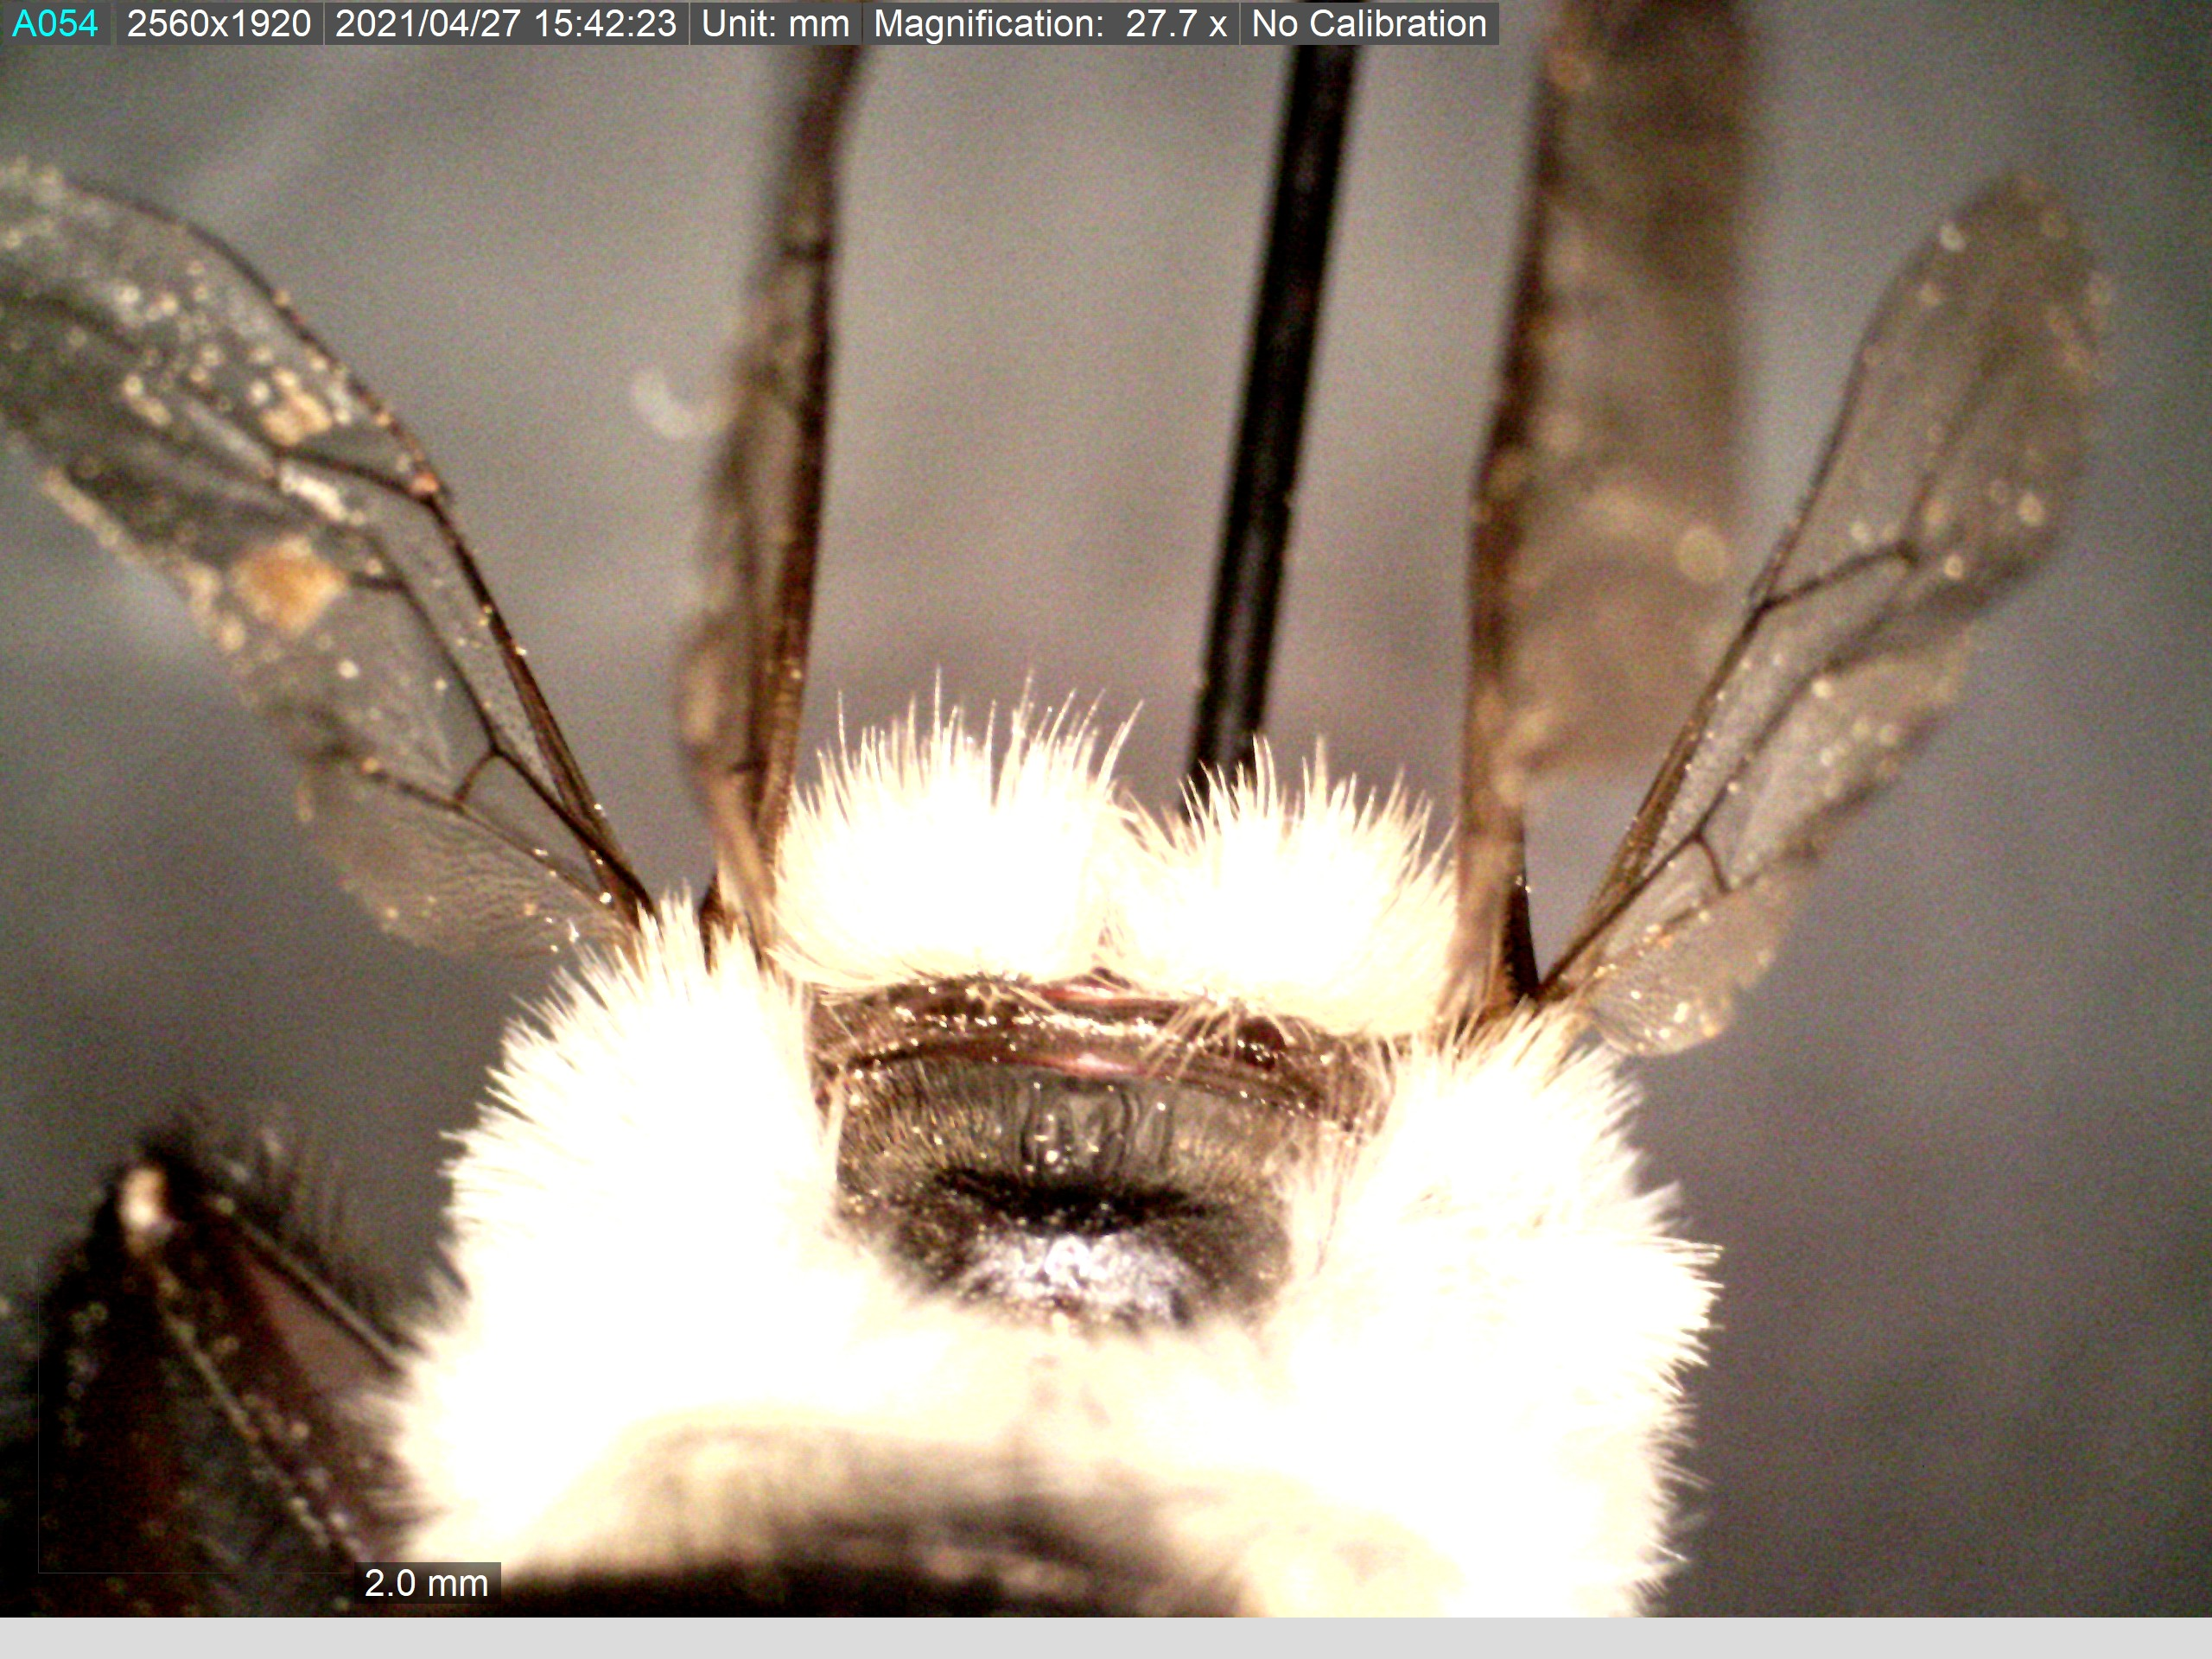
Length of hair on posterior side of thorax

Slide 11
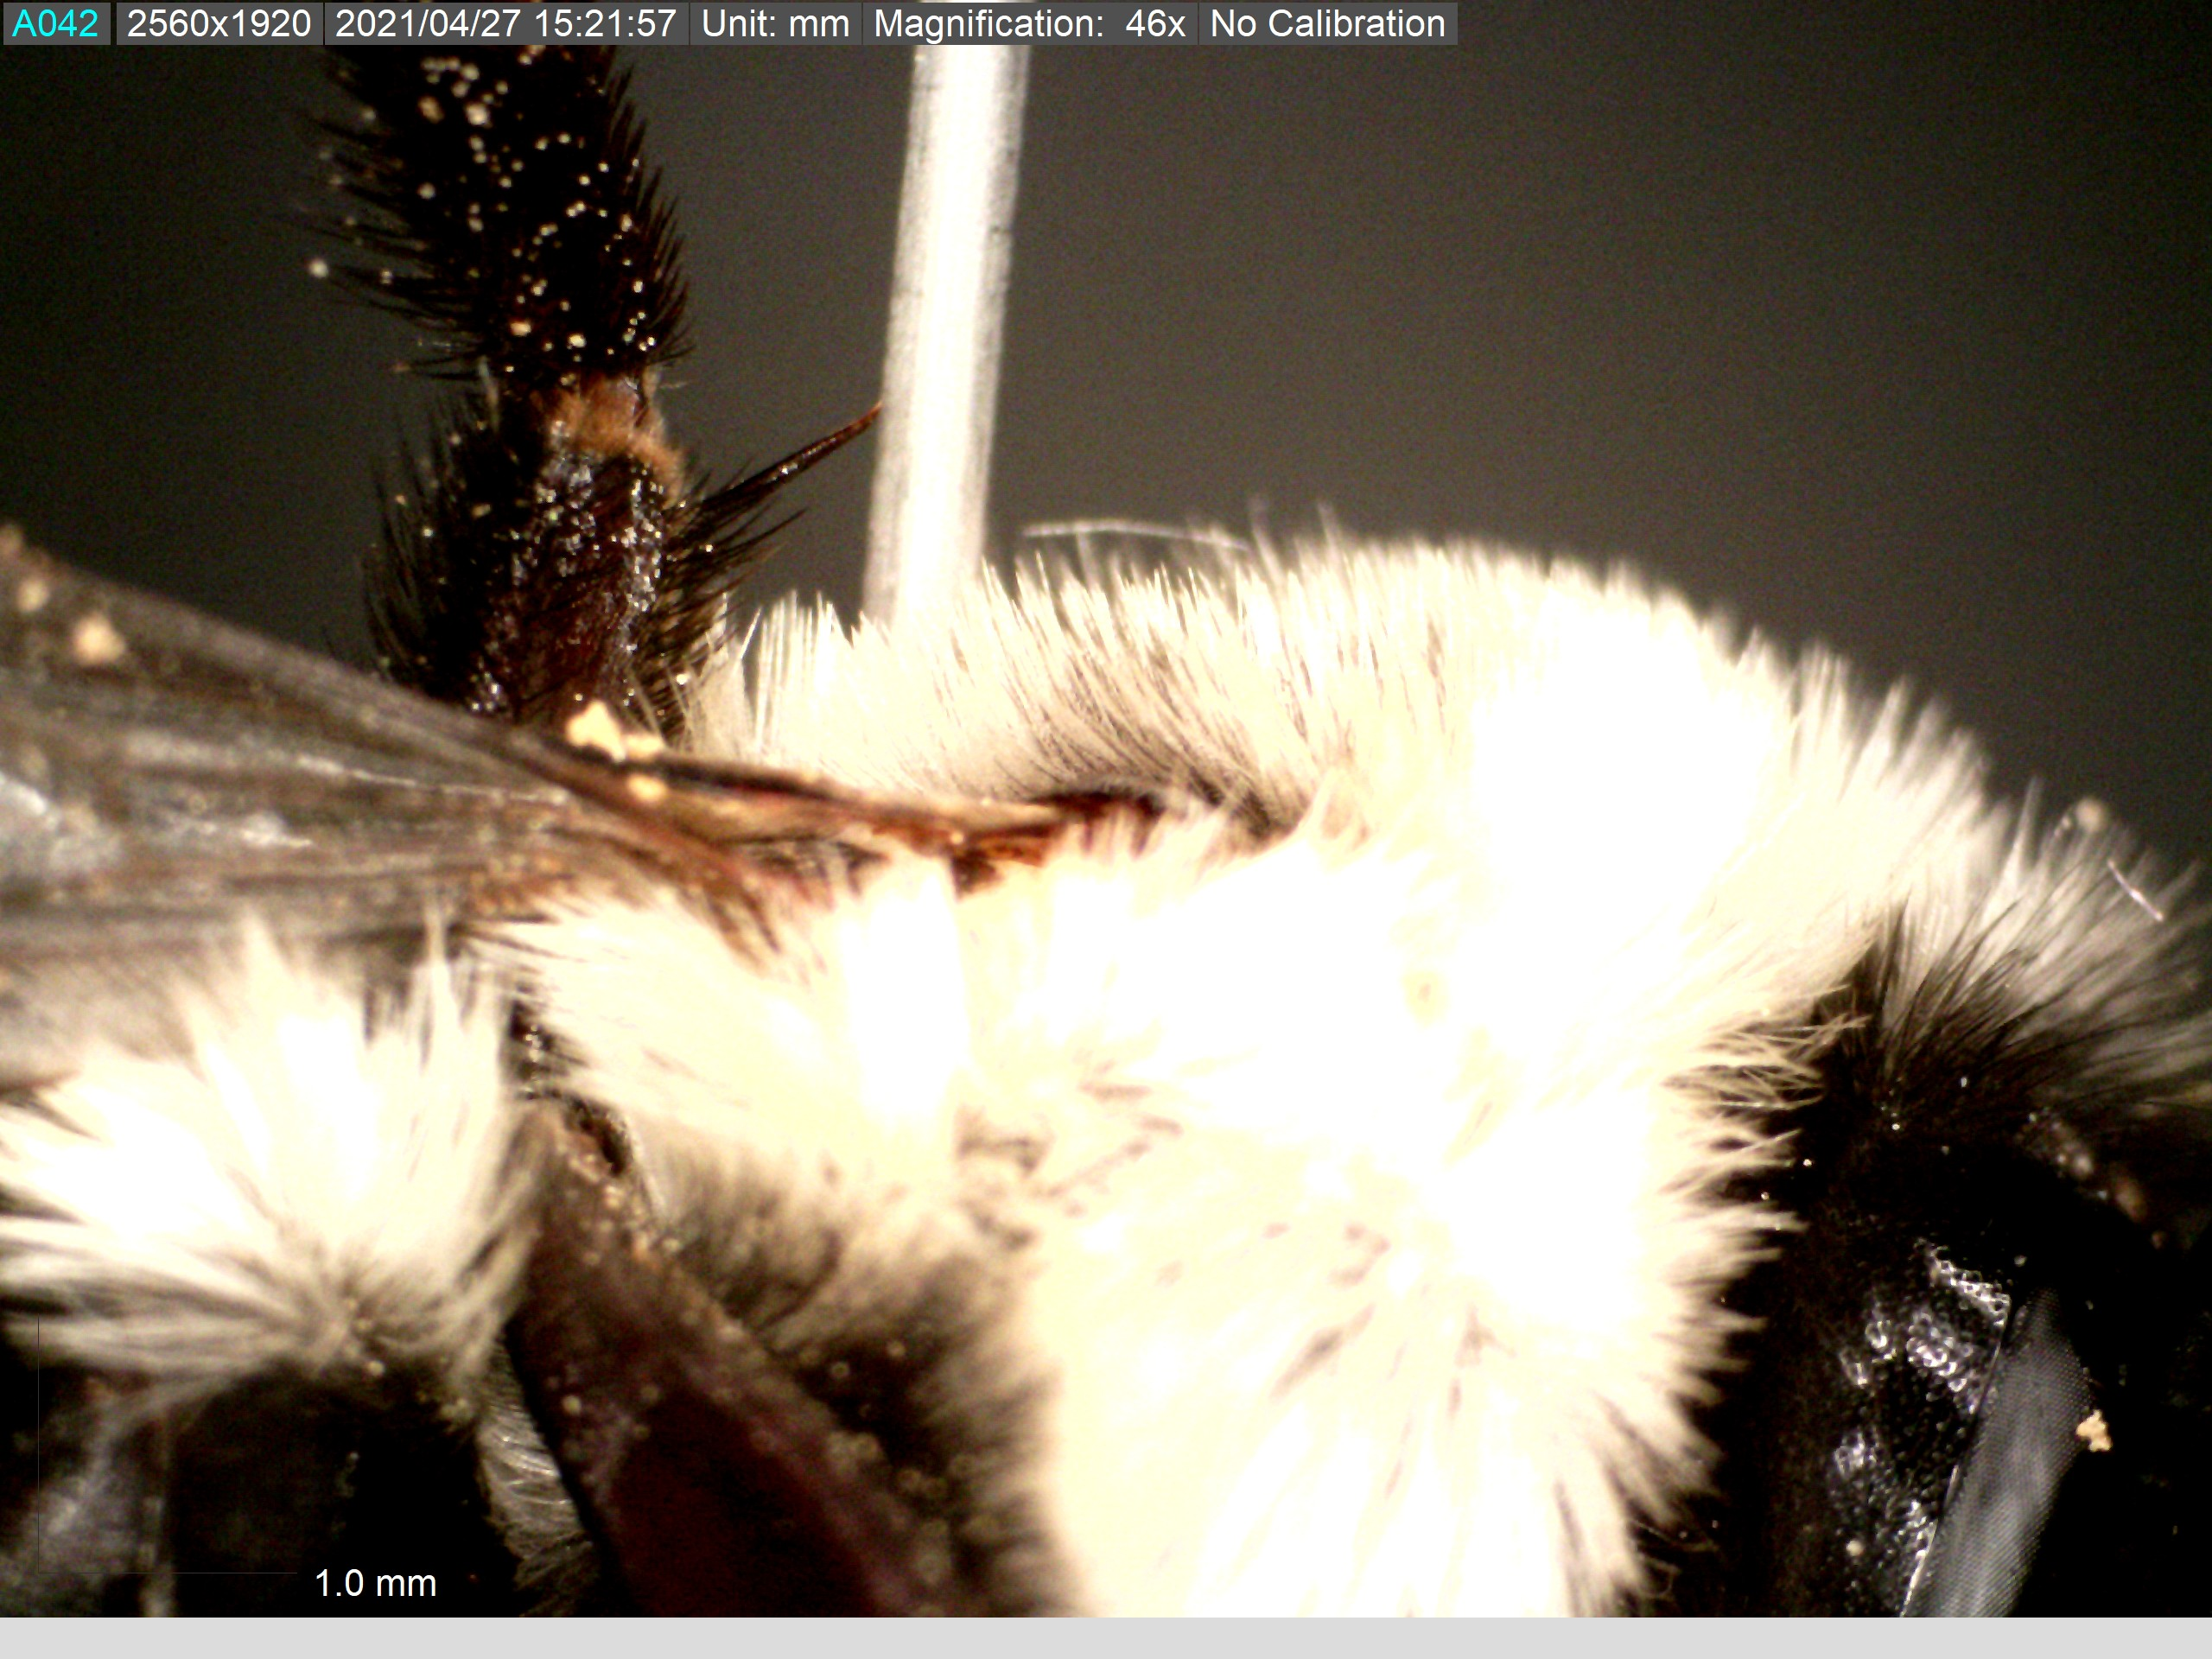
Length of hair on side of thorax

Slide 12
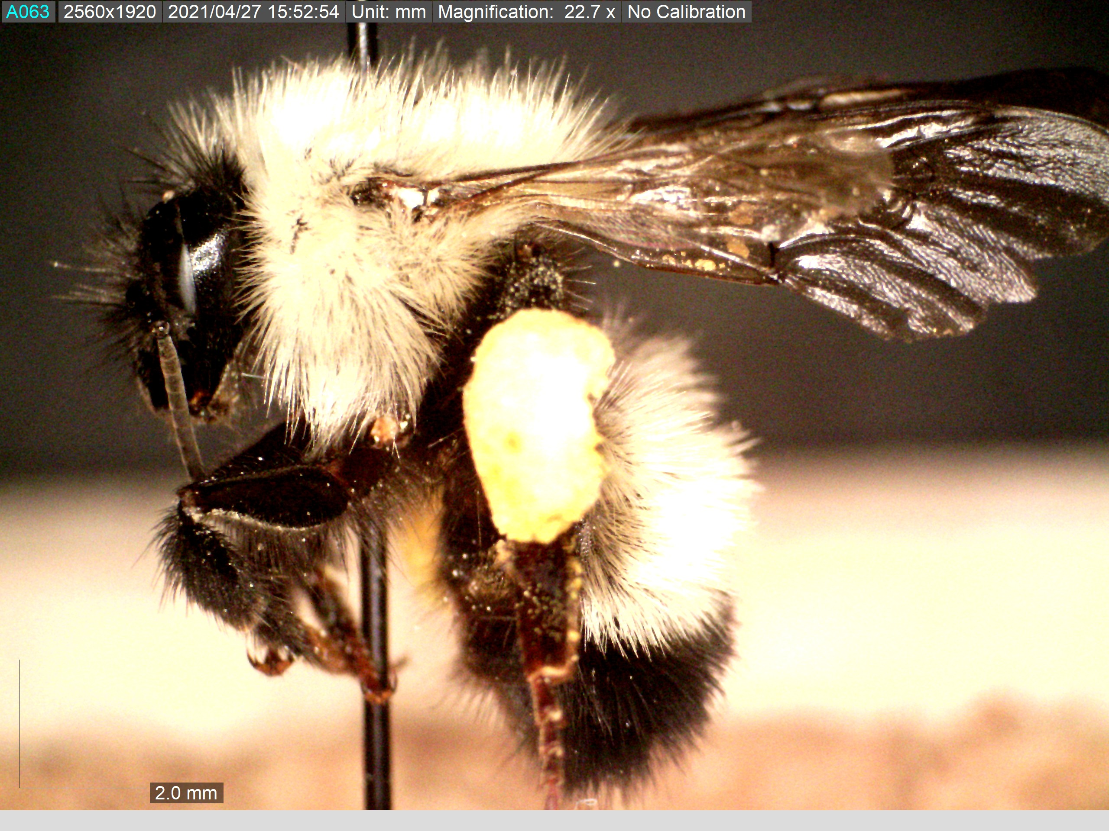

Slide 13
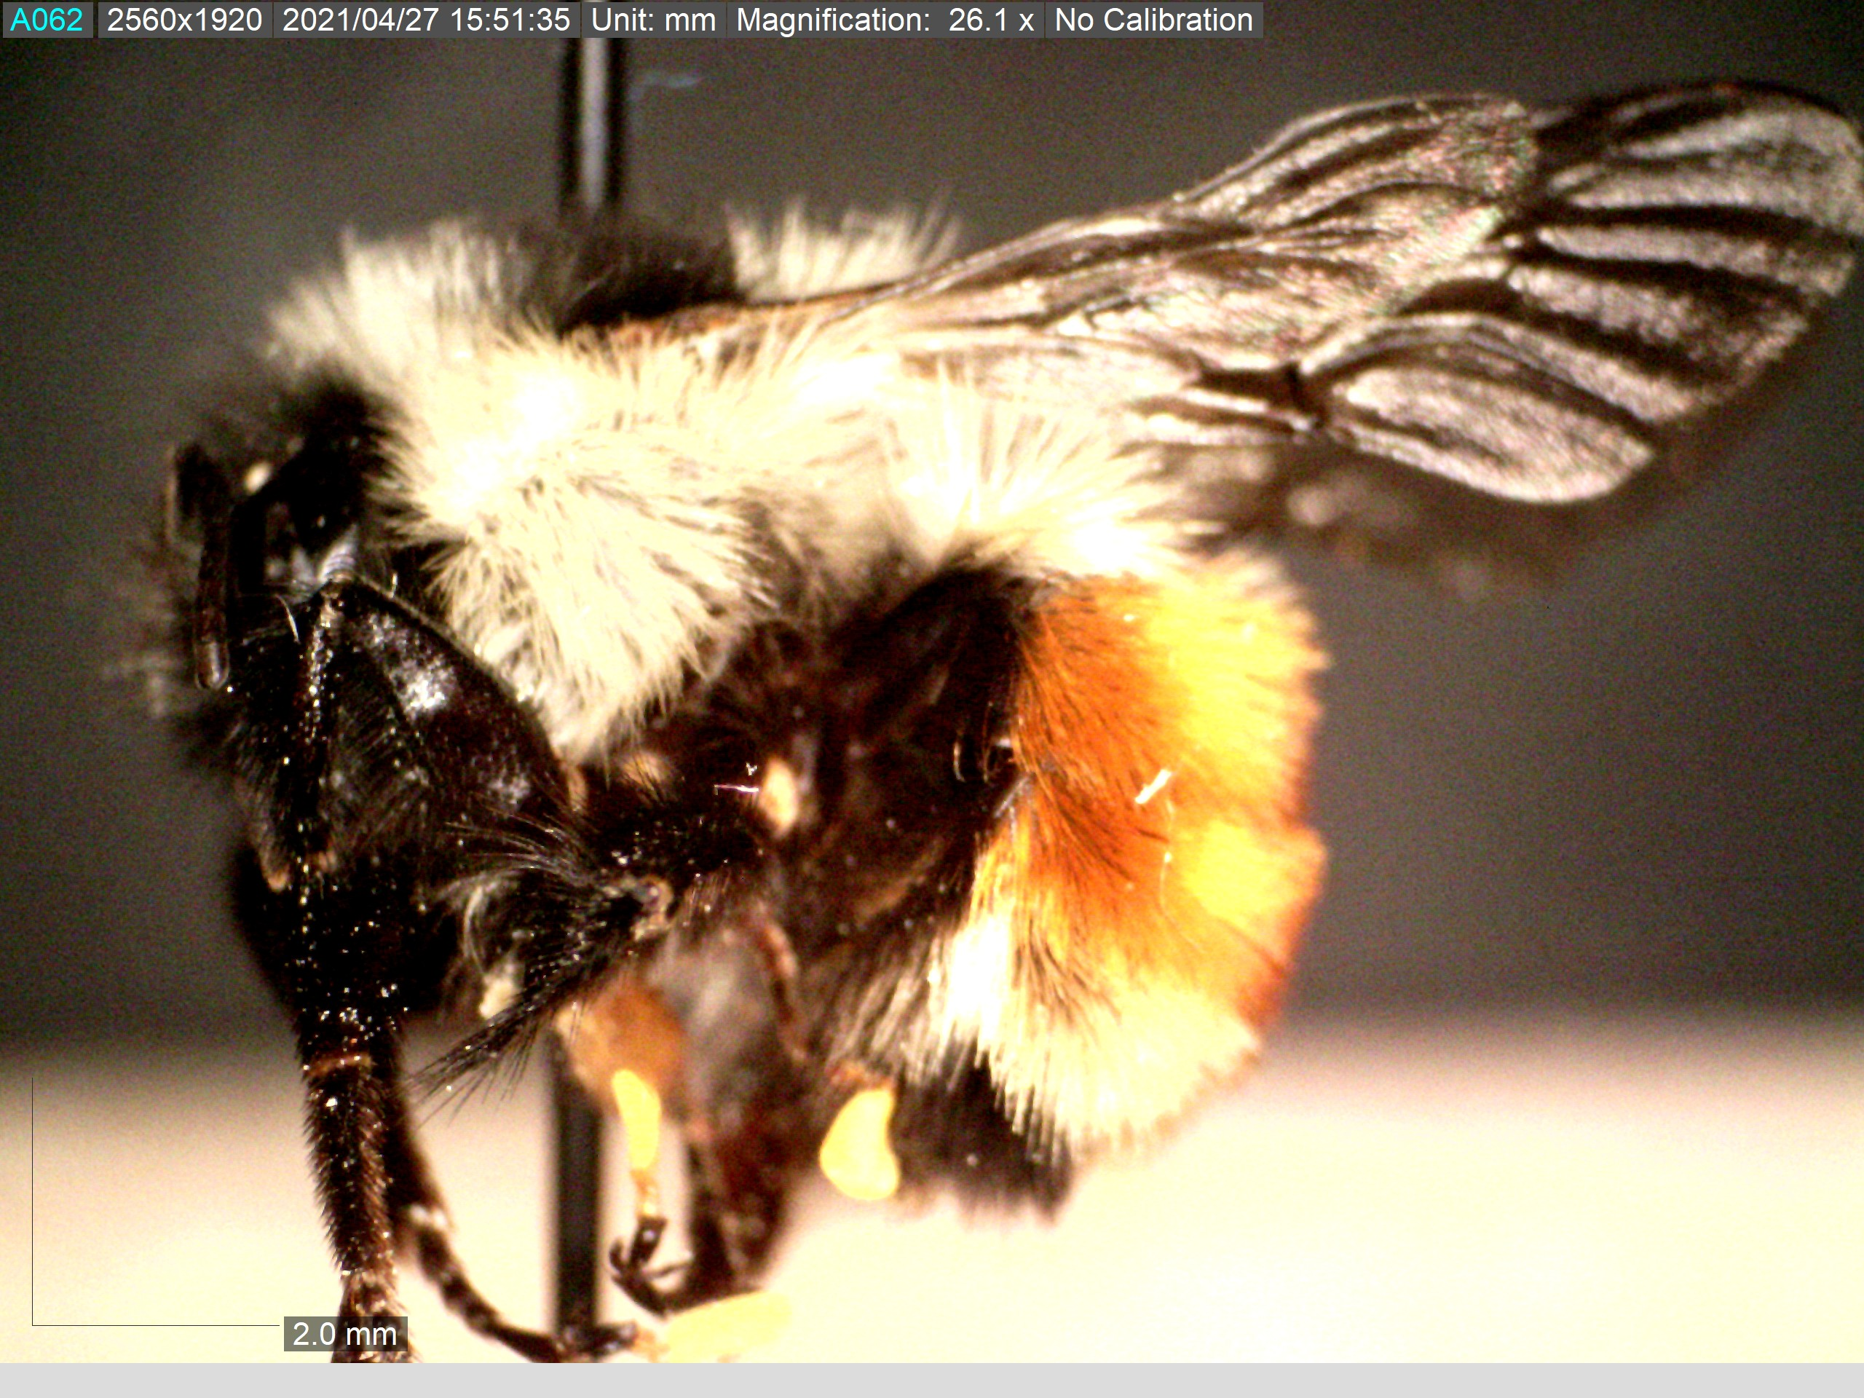

Slide 14
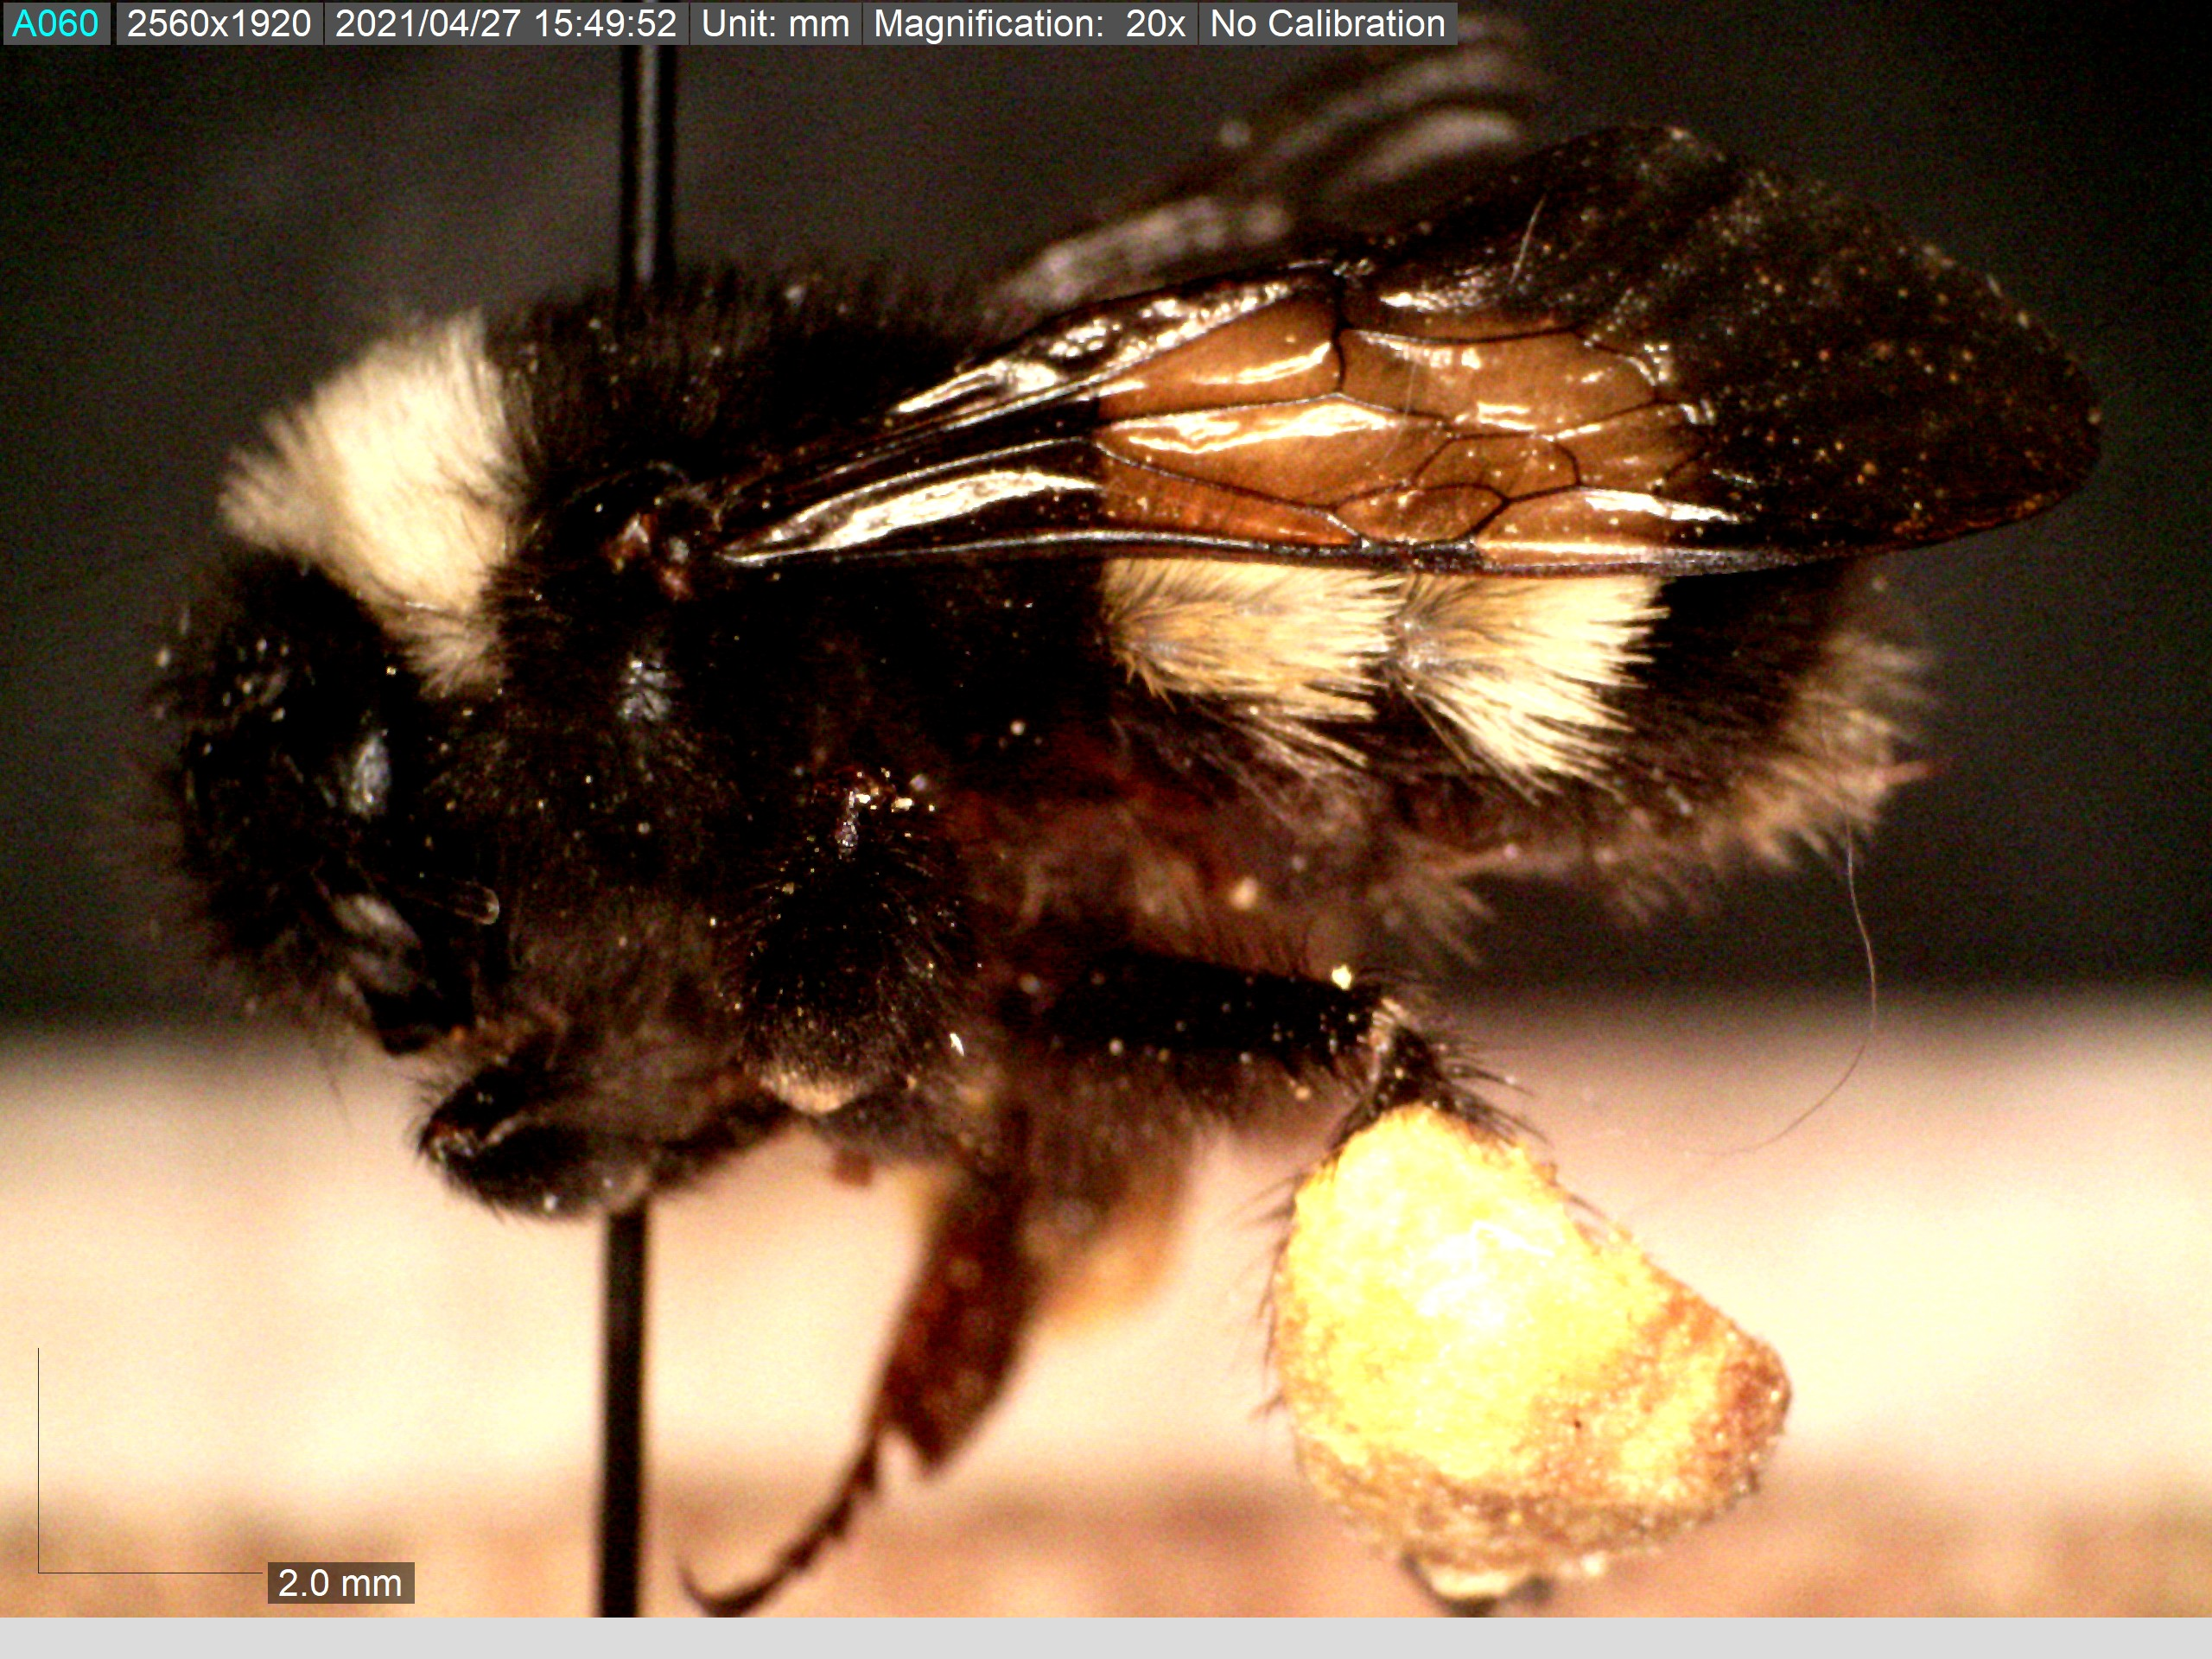

Slide 15
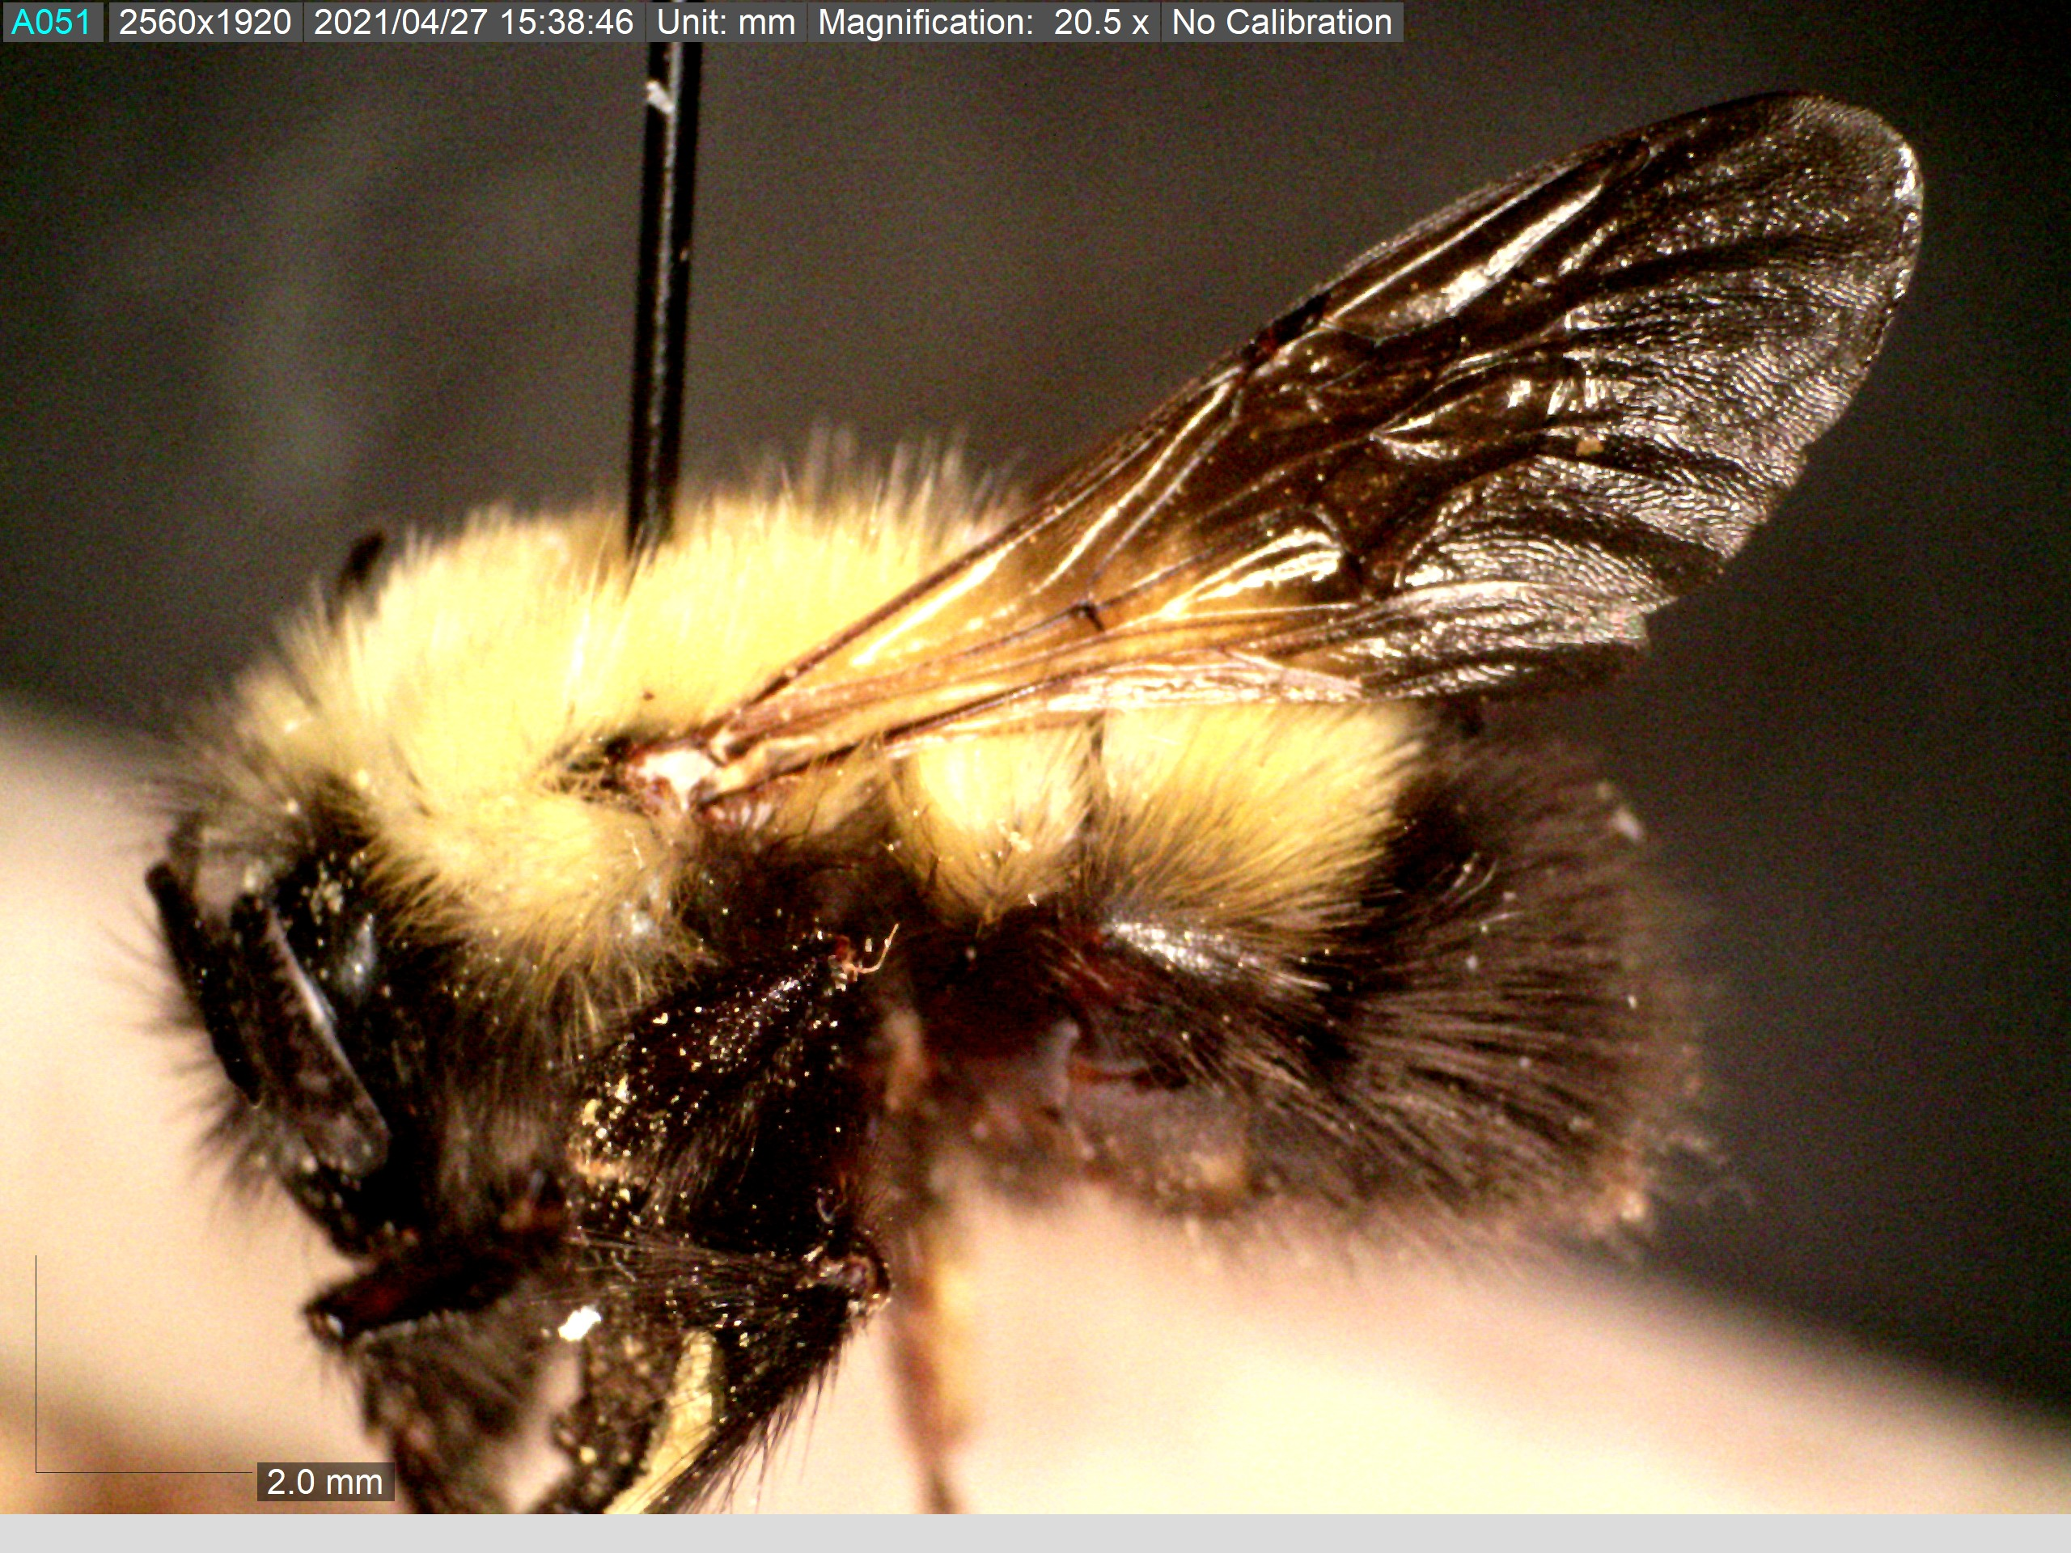
Length of wing

Slide 16
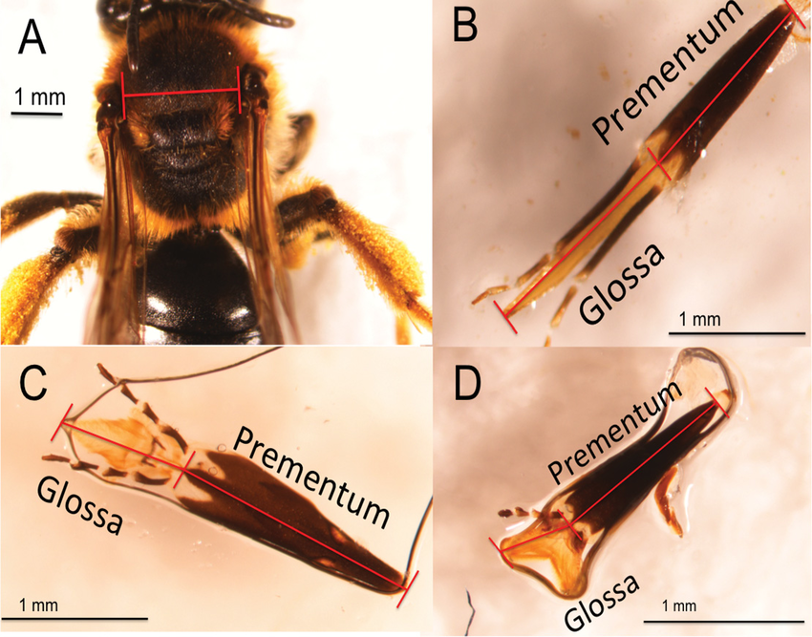
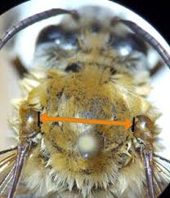
Intertegular Distance

Slide 17
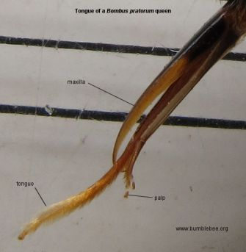
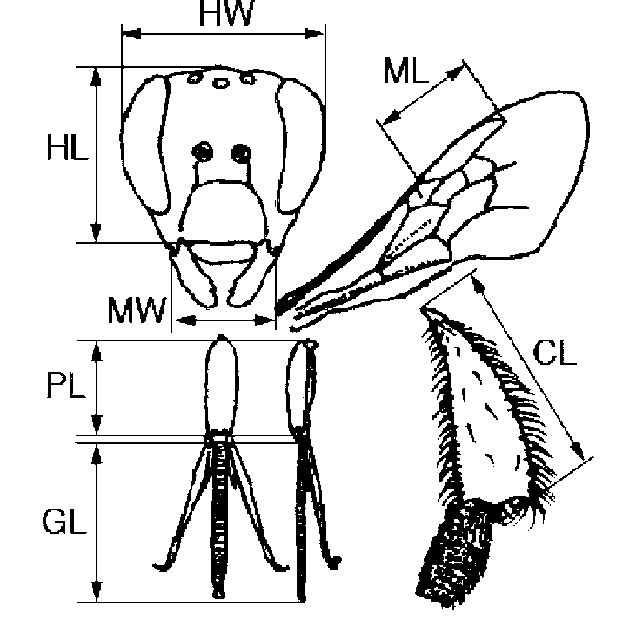
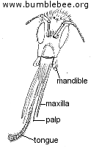
Wing Length
Basitarsus length
Notes:
Caption
Fig. 2 Morphological measurements for bumblebees; HW head width, HL head length, MW distance between the bases of mandibles, PL prementum length, GL glossa length, ML marginal cell length of the fore wing, and CL corbicular length of the hind leg

